Slide 1
Unit 2: Writing process
Wang Qi
College of Foreign Language & Literature, NWNU
Notes:
This template can be used as a starter file to give updates for project milestones.
Sections
Sections can help to organize your slides or facilitate collaboration between multiple authors. On the Home tab, under Slides, click Section, and then click Add Section.
Notes
Use the Notes pane for delivery notes or to provide additional details for the audience. You can see these notes in Presenter View during your presentation.
Keep in mind the font size (important for accessibility, visibility, videotaping, and online production)
Coordinated colors
Pay particular attention to the graphs, charts, and text boxes.
Consider that attendees will print in black and white or grayscale. Run a test print to make sure your colors work when printed in pure black and white and grayscale.
Graphics, tables, and graphs
Keep it simple: If possible, use consistent, non-distracting styles and colors.
Label all graphs and tables.

Slide 2
Objectives
To get a sense of 5 prewriting techniques.
To get familiar with 4 basic steps in Essay Writing .
To get an overview framework of revising your essays.
Notes:
What is the project about?
Define the goal of this project
Is it similar to projects in the past or is it a new effort?
Define the scope of this project
Is it an independent project or is it related to other projects?
* Note that this slide is not necessary for weekly status meetings

Slide 3
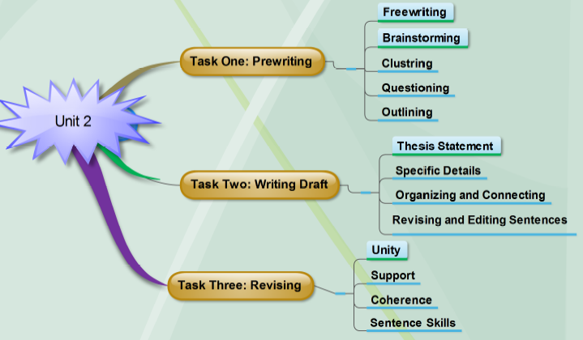
Notes:
* If any of these issues caused a schedule delay or need to be discussed further, include details in next slide.

Slide 4
TASK ONE 5 Prewriting Techniques
Freewriting
Brainstorming
Clustering
Questioning
Outlining
Notes:
Duplicate this slide as necessary if there is more than one issue.
This and related slides can be moved to the appendix or hidden if necessary.

Slide 5
Freewriting
“I can’t think of anything special just now, nothing really comes to mind, well may be something about downtown mall would be good because I wouldn’t mind spending time down there. Something about the mall… maybe the street vendors, the hot dog guy or that woman selling T shirts, they are always there, even in lousy weather…. Actually, all winter, do they need the money that bad? Why people become street vendors—like maybe they graduate from college and couldn’t get jobs? Or were these the guys who never wanted anything to do with college.”

Slide 6
Brainstorming (List Making)
Traffic is bad
Noisy patrons
Hard to be on the diet
Kids running in aisles
I’m crowded into seats between strangers
Not enough parking
Parking lot needs to be expanded
Too many previews
Long lines
High ticket price
Too many commercials on the screen
Tubs of popcorn with butter
Huge chocolate bars
People coughing and sneezing
Icky stuff on floor
Teenagers yelling and showing off

Slide 7
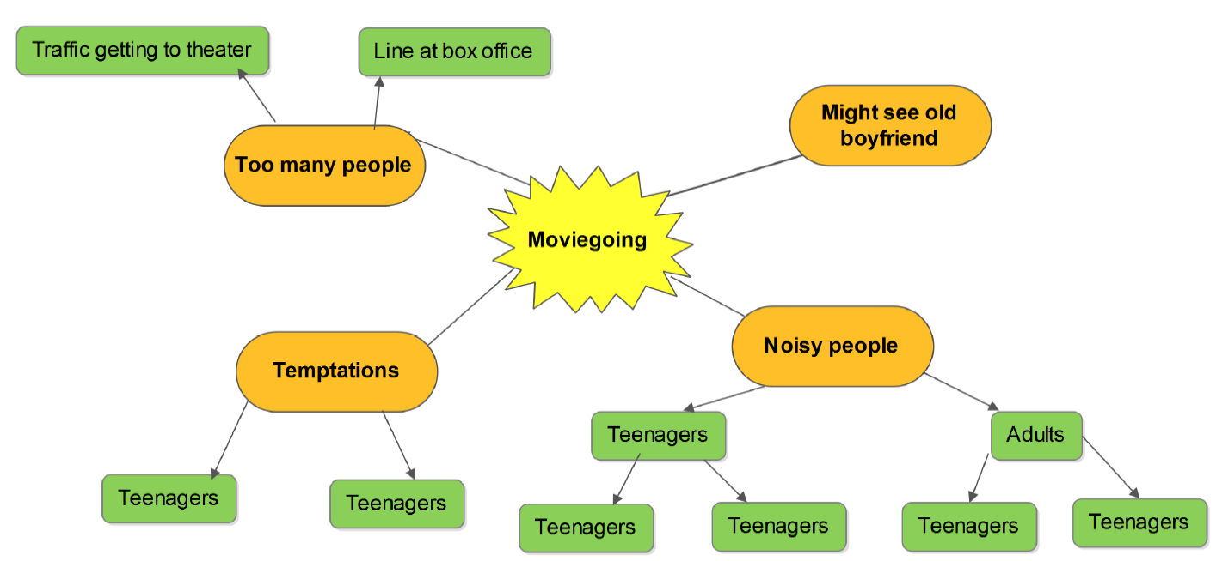
Clustering

Slide 8
Questioning
Why don’t I like to go to a movie?
When is going to movie a problem? Where are the problems with moviegoing?
Who makes the problem?
How can I deal with the problem?
(See the details in Lang an,2013,pp25)

Slide 9
Outlining
American Fast Food: Why is it So Popular in China?
Ⅰ. American fast food in China
A. American Fast Food Restaurants in China
1. McDonald’s
2. KFC
3. Pizza Hut
B. Food Served by These Restaurants
Burgers
Sandwiches
Fried chicken
…
Ⅱ. Reasons for Popularity
Service
Fast
Friendly
Convenient
Taste
Different from typical Chinese food
Novel to Chinese taste buds
Consumer Psychology
Customer demographics (city residents, tourists, age group, income, etc.
Ⅲ. Effects of this Popularity
Positive effects …
Negative effects …

Slide 10
TASK TWO 4 Steps of Essay Writing
1. Thesis Statement
2. Specific Details
3. Organizing &
Connecting
4. Revising
& Editing

Slide 11
Activity 2.1 Thesis Statement
A good thesis statement:
tells an essay’s topic.
presents the writers’ attitude, opinions, ideas, or point
about the topic.
1. “Owning a pet has several important benefits”
The topic is “owning a pet”; the writer’s main point is the
owning a pet “has several important benefits”.
2. “Living in the city has certain advantages over living in the
suburbs.”

Slide 12
Writing a Good Thesis
Write statements, not announcements.
“I want to talk about the crime wave in our country”
“The resent crime wave in our country has several apparent causes.”
Make sure statements develop only one idea.
“Studying with others has several benefits, but it also has drawbacks and
can be difficult to schedule.”
“Studying with others has several benefits”
Avoid statements that are too narrow.
“The speed limit near my home is 65 miles per hour”
“The speed limit near my home should be lowered to 55 miles per hour
for several reasons”

Slide 13
Writing a Good Thesis
Avoid statements that are too broad.
“Men and women are very different”
“Men and women are often treated differently in the workplace”
General Limited Thesis Statement
Topic Topic
Marriage Honeymoon A honeymoon is perhaps the worst way to begin a
marriage
Children Disciplining of My husband and I have several effective ways of
Children disciplining of our children
Sports Players’ salaries Players’ high salaries are bad for the game,
for the fans, for the value our children are developing

Slide 14
Let’s revise the following thesis statements in pairs.
Now, revise the following thesis statements in the box.
The baby boom generation is the concern of this essay.
The baby boom generation has Changed American in key ways. In the 1980s, AIDS changed people’s attitudes about dating. The speed limit near my home should be lower to55 miles per hour for several reasons. Teachers have played an important role in my life.
Disease has shaped human history.
The speed limit near my home is 65 miles per hour.
Teachers have played an important role in my life, but they were not as important as my parents.

Slide 15
Activity 2.2 Specific Details
Vague Support
1. Many people in the theater show
themselves to be inconsiderate. They make noises and create disturbances at their seats.
And people are often messy, so that you are constantly aware of all the food they are eating.
3. People are always moving around near you, creating a disturbance and interrupting your enjoyment of the movie.
Specific Support
Little kids race up and down the aisles, usually in giggling packs. Teenagers try to impress their friends by talking back to the screen, whistling and making what they consider to be hilarious noises.
. Any people of all ages crinkle candy
wrappers, stick gum on their seats, and drop
popcorn tubs or cups of crushed ice and
soda on the floor.
. They also cough and burp, squirm endlessly
in their seats, file out for repeated trips to
the rest rooms or concession stand, and
elbow you out of the armrest on either side
of your seat.

Slide 16
Lets’ do the following exercises
_______1. The people who have moved in beside us are unpleasant neighbors
They barely say “Hi” when we’re in our neighboring yards. When
we are invite them to our neighborhood barbecue, they said they
were going to be busy. They sometimes turn loud music on late at
night, and we have to close our windows to shut out the noise. To
tip it off, they let their dog roam free in our street.
________2. Pet can be more trouble than children
My dog, unlike my children, has never been completely housebroken.
When he’s excited or nervous, he still has an occasional problem. He
has never learned how to take care of himself when we are away,
despite the fact that we’ve given him plenty of time to do so. We don’t
have to worry about our grown children anymore. However, we still
have to hire a dog-sitter.

Slide 17
Activity2.3 Organizing and Connecting
Activity2.3 Organizing and Connecting
To exercise successfully, you should follow a simple plan:
To begin with, set aside a regular hour for exercise.
Next, prepare for your exercise session.
Finally, do a series of warm-up activities.
Time Order: means that details are listed as they
occur in time. First this is done; next this;
then this; after that; and so on.
To exercise successfully, you should follow a simple plan:
To begin with, set aside a regular hour for exercise.
Next, prepare for your exercise session.
Finally, do a series of warm-up activities.

Slide 18
“saving the best till last”
Emphatic order (ascending order递增顺序):
arranges your ideas according to their
importance. Finally, last of all, and most
important are the typical words or phrases.
Celebrities lead very stressful lives.
For one thing, celebrities don’t have the privacy as
ordinary person does.
In addition, celebrities are under constant pressure.
Most important, celebrities must deal with the stress
of being in constant danger.

Slide 19
It’s your turn to find the transitional words according to the category in groups.
to find the transitional words according to the category in the box.
Addition signals: one, in addition, Time signals: first, Space signals: next to, Change-of-direction signals: but Cause and effect signals: As a result, Comparison and contrast signals: Similarly, Illustration signals: for instance, Conclusion signals: therefore,

Slide 20
Addition signals: one, first of all, second, also, in addition, besides, next, another
one, moreover, furthermore , finally, last of all.
Time signals: first, then, after, before, while, meanwhile, soon, now, during, finally.
Space signals: next to, across, on the opposite side, to the left, to the right, above,
below, near, nearby.
Change-of-direction signals: but, however, yet, in contrast, although, otherwise,
still, on the contrary, on the other hand
Cause and effect signals: As a result, as a consequence, consequently, therefore,
due to, because
Comparison and contrast signals: Similarly, in the same way, in contrast, on one
hand, on the other hand.
Illustration signals: for instance, specifically, as an illustration. Once, such as.
Conclusion signals: therefore, consequently, in short, in a word, to sum up, in
summary, to conclude, in conclusion

Slide 21
To begin with, …
Next,…
Then,…
Later,…
Finally,…
One reason,…
Another reason, …
A further reason,…
The final reason,…
For one thing,…
In addition,…
Most important, …
Furthermore,…
Besides…, …
In addition, …
Moreover, …
At this point,…
After this,…
Finally,…

Slide 22
For Summarizing:
In short, …
In a word, …
In brief,…
To sum up, …
In summary, …
For Concluding:
In conclusion, …
On the whole, …
Altogether, …
In all, …
From above discussion, we
can draw a conclusion
that…

Slide 23
Well-organized essay
Introduction
Begin with a broad, general statement of your topic and narrow it down to your thesis statement.
Star with an idea or a situation that is the opposite of the one you will develop.
Explain the importance of your topic to the reader.
Use an incident or a brief story.
Ask one or more questions and use a quotation.

Slide 24
An effective Concluding paragraph
End with summary and final thought.
Include a thought-provoking questions or short series of questions.
End with a prediction or recommendation.

Slide 25
Task Three: Revising (4 bases)
Four Steps Four Bases
1. If you advance a single point your paper will have unity.
and stick to that point,
2. If you support the point with your paper will have support.
specific details,
3. If you organize and connect your paper will have coherence.
the specific details,
4. If you write clear, error-free your paper will demonstrate effective
sentences, sentence skills.

Slide 26
Task Four: Writing Activities
Writing Activities in teaching notes

Slide 27
THANK YOU FOR YOUR TIME AND PATIENCE!

